Slide 1

L20 Managing State: PHP Ch 15

Slide 2
In this chapter you will learn . . .
Why state is a problem in web application development
What cookies are and how to use them
What session state is and what are its typical uses and limitations
What server cache is and why it is important in real-world websites

Slide 3
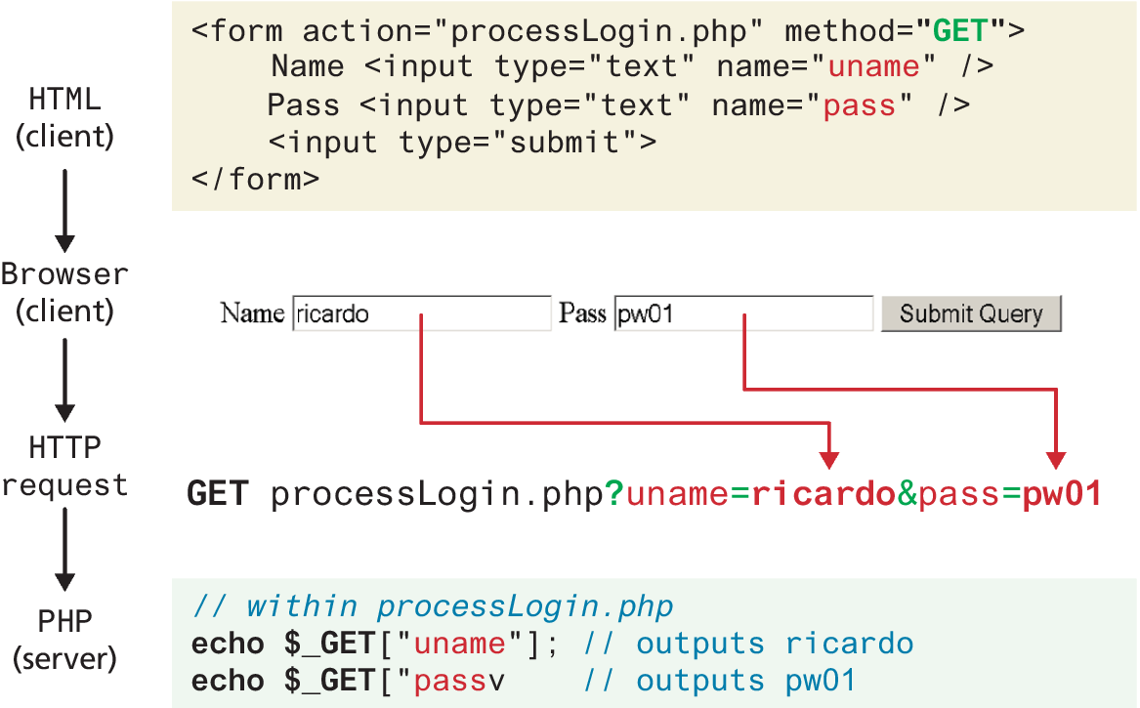
Illustration of flow into $_GET array

Slide 4
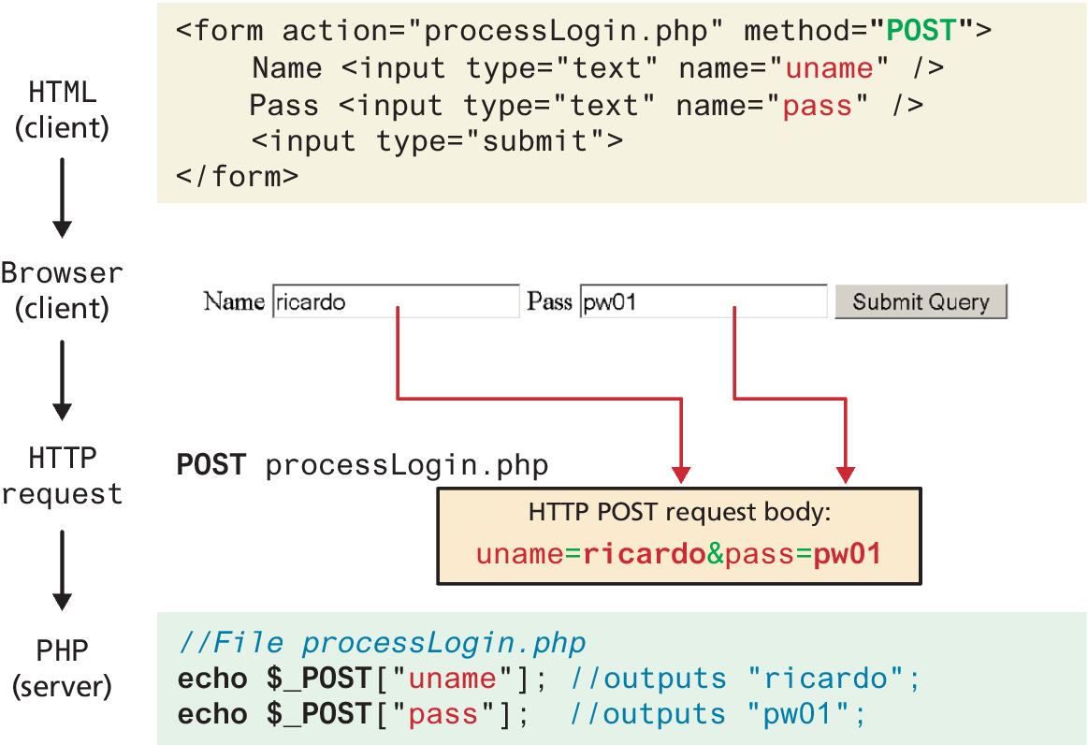
Illustration of flow into $_POST array

Slide 5
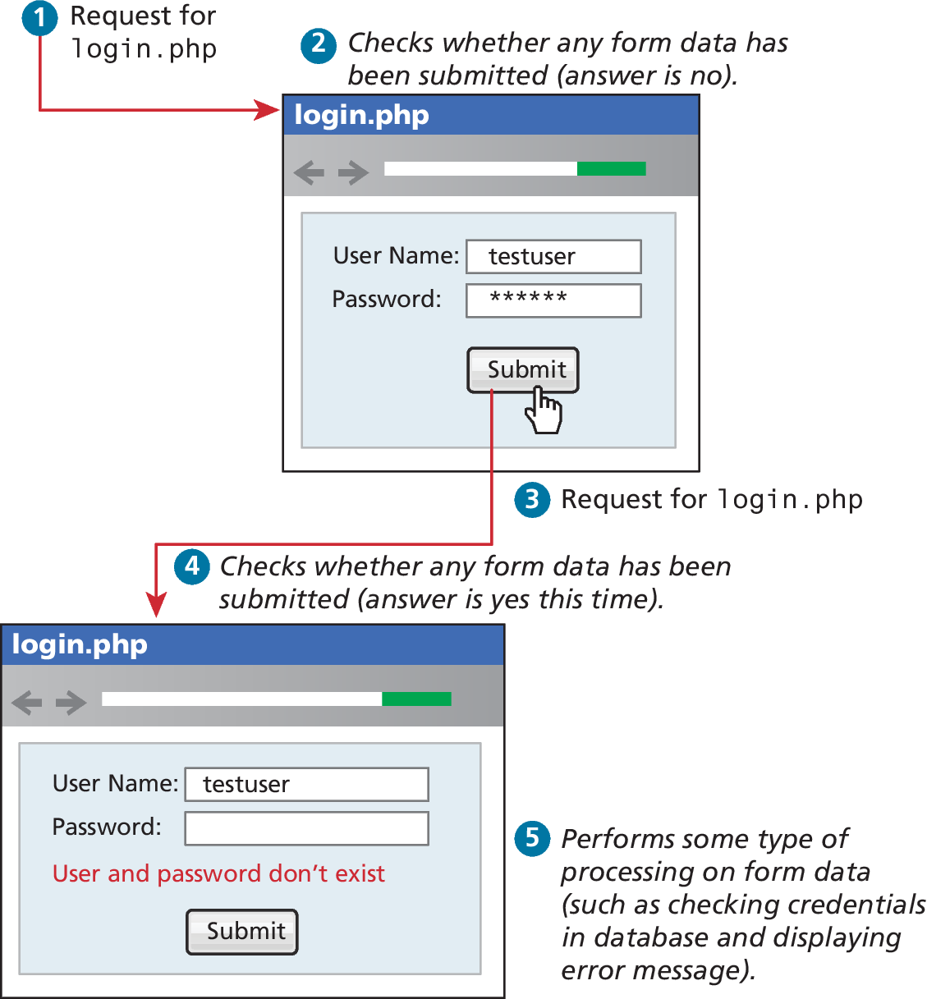
Determining If Any Data Sent
<?php
if ($_SERVER["REQUEST_METHOD"] == "POST") {
if ( isset($_POST["uname"]) && isset($_POST["pass"]) ) {
// handle the posted data.
echo "handling user login now ...";
echo "... here we could redirect or authenticate ";
echo " and hide login form or something else";
}
}

Slide 6
Accessing Form Array Data
Sometimes in HTML forms, you might have multiple values associated with a single name. Unfortunately, if the user selects more than one day and submits the form, the $_GET['day'] value in the superglobal array will only contain the last value from the list that was selected.
To overcome this limitation, you must change the HTML in the form. In particular, you will have to change the name attribute for each checkbox from day to day[]
echo "You submitted " . count($_GET['day']) . "values";
foreach ($_GET['day'] as $d) {
echo $d . " <br>";
}
LISTING 12.34 PHP code to display an array of checkbox variables

Slide 7
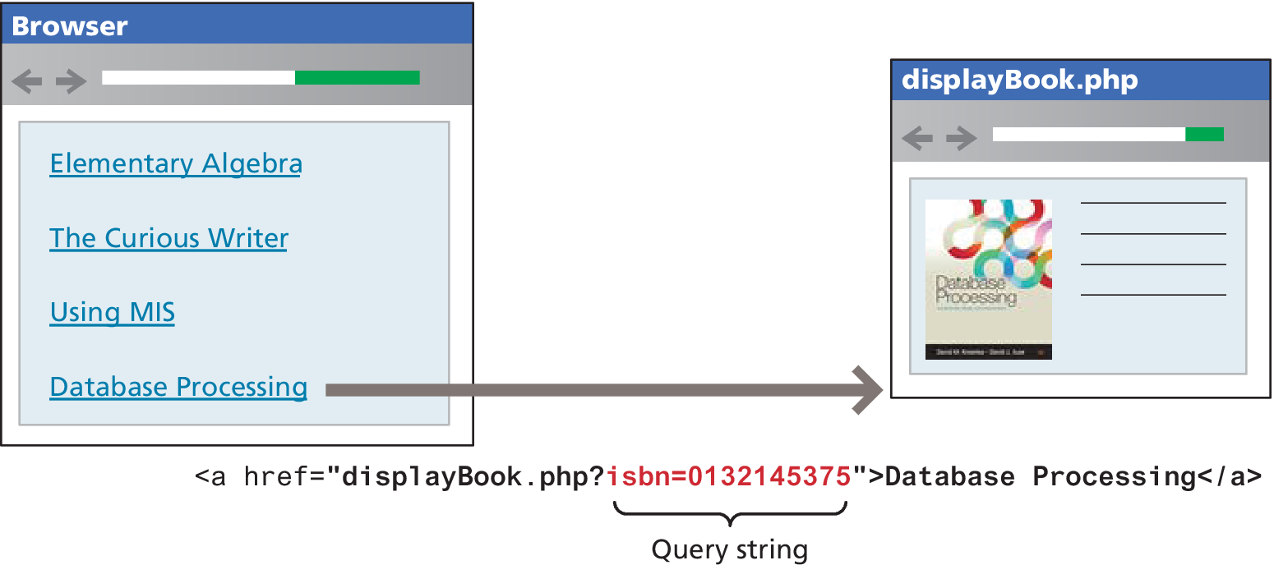
Using Query Strings in Hyperlinks

Slide 8
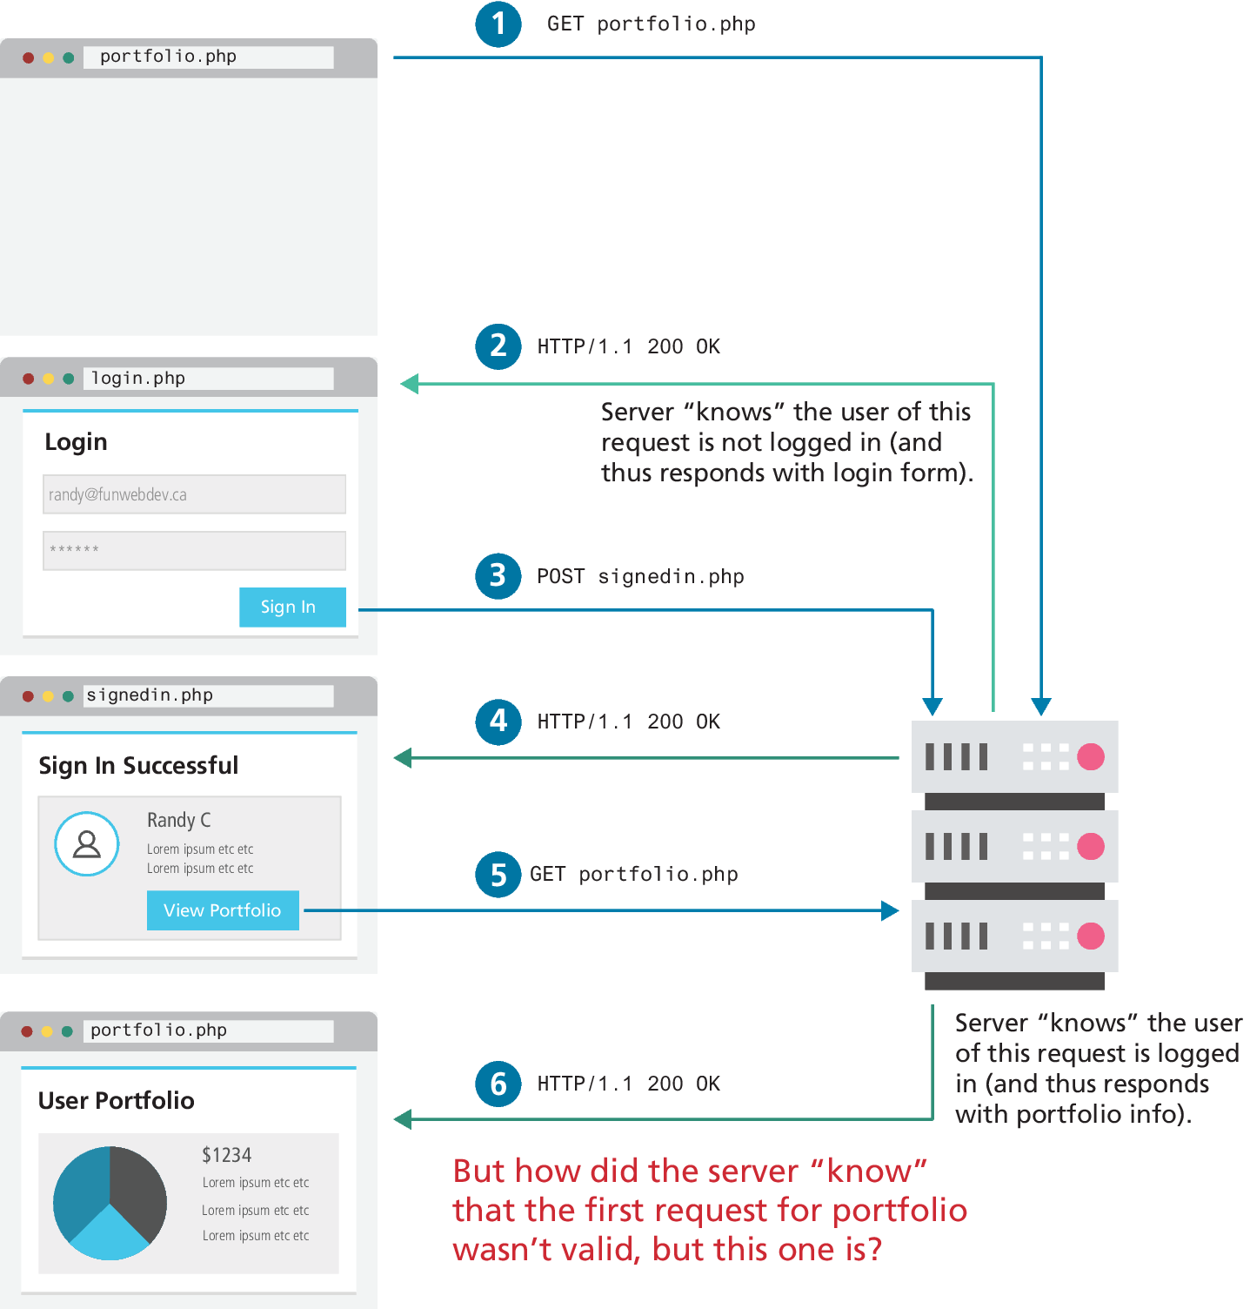
The Problem of State in Web Applications
How can one request share information with another request?
The question is: how did the server "know" when the user was and was not logged in? →

Slide 9
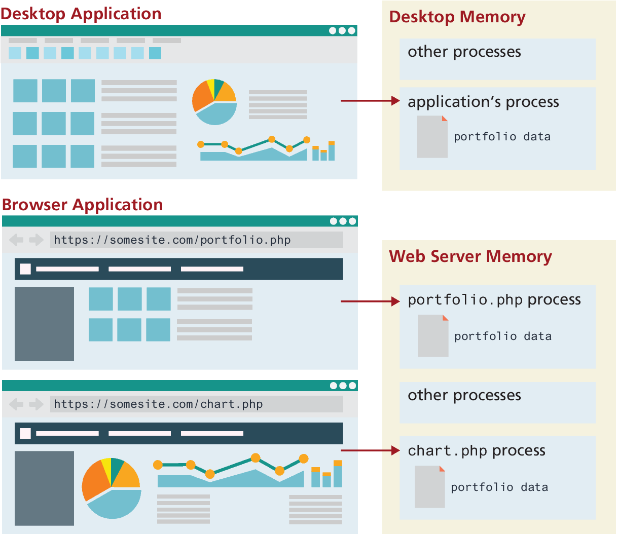
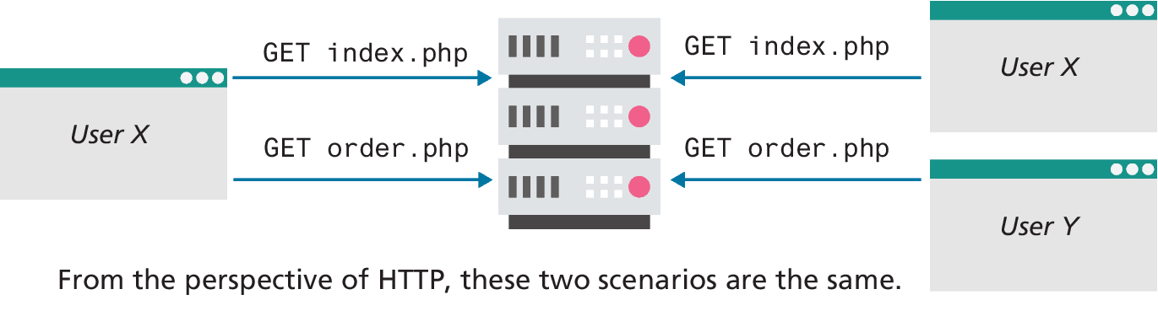
The Problem of State in Web Applications (ii)
Unlike a desktop application, A web application consists of a series of disconnected HTTP requests to a web server where each request for a server page is essentially a request to run a separate program

Slide 10
Passing Information in HTTP
In HTTP, we can pass information using:
URL
HTTP header
Cookies

Slide 11
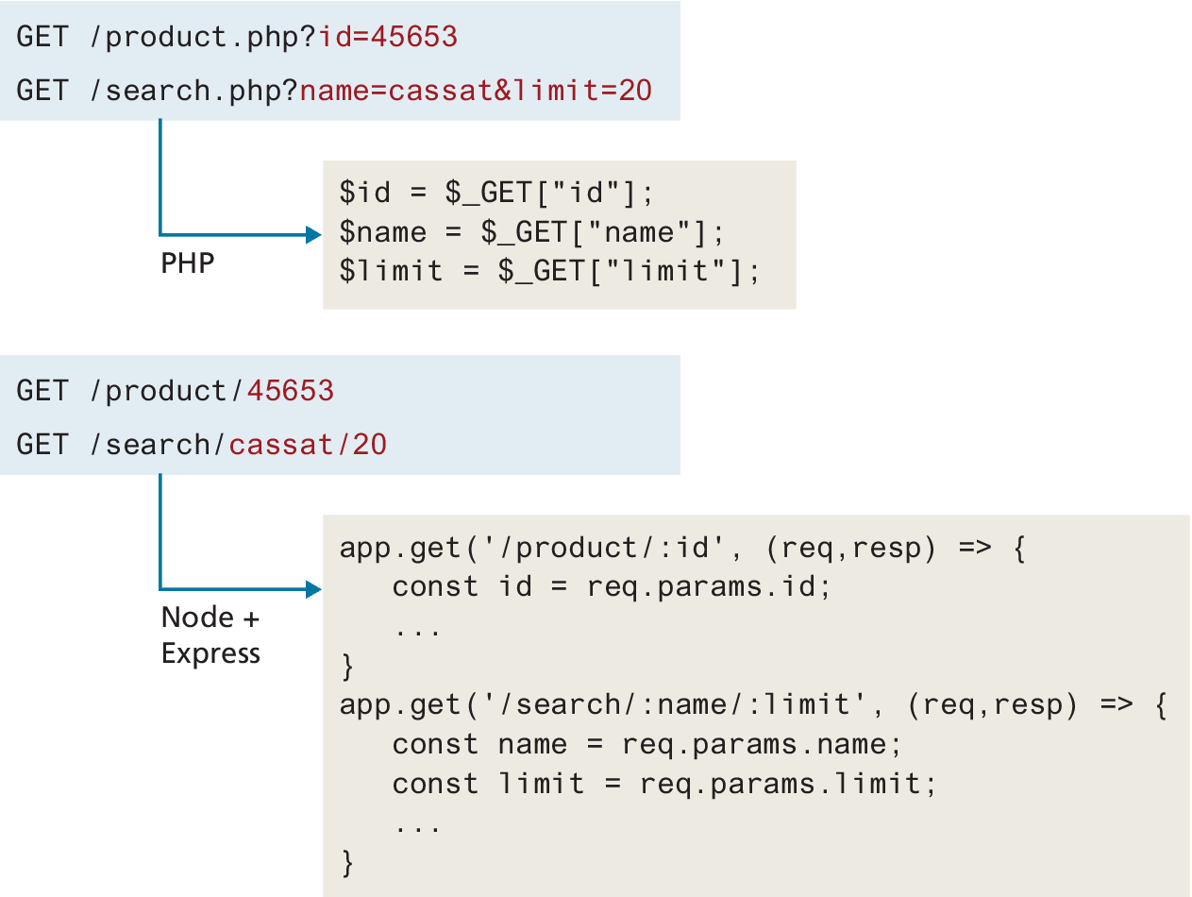
Passing Information via the URL
Recall a web page can pass query string information from the browser to the server using one of the two methods:
a query string within the URL (GET) →
a query string within the HTTP header (POST).

Slide 12
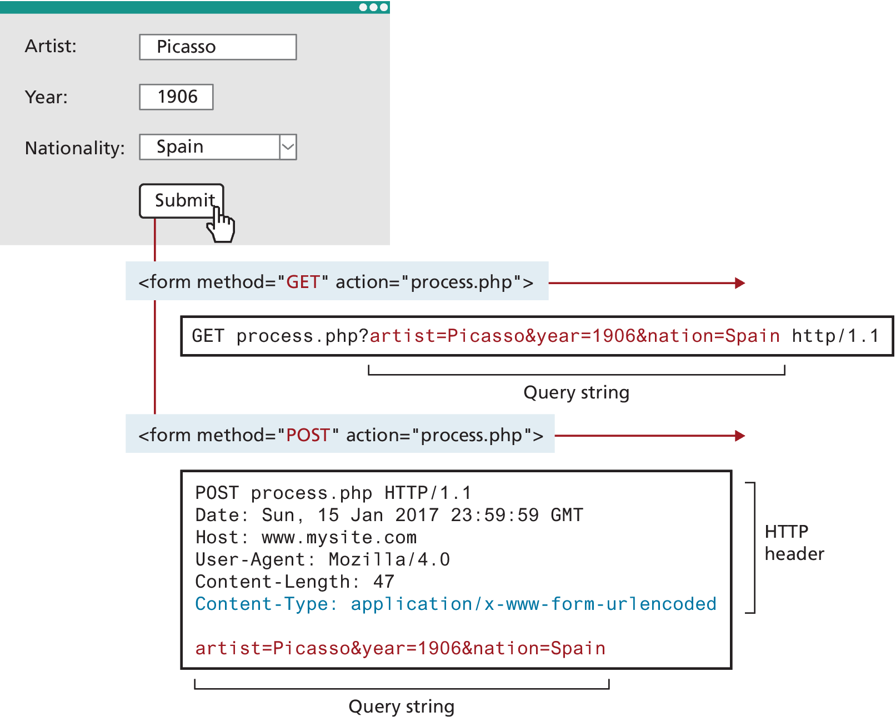
Passing Information via HTTP Header
You can see that the form data sent using the POST method is sent as a query string after the HTTP header.
Think of this data being passed via the HTTP header
Another way that a browser can send data to the server is via JSON data

Slide 13
Cookies
Cookies are a client-side approach for persisting state information.
They are name=value pairs that are saved within one or more text files that are managed by the browser.
While cookies can be used for any state-related purpose, they are principally used as a way of maintaining continuity over time in a web application. One typical use of cookies in a website is to “remember” the visitor so that the server can customize the site for the user.
Cookies are also frequently used to keep track of whether a user has logged into a site.

Slide 14
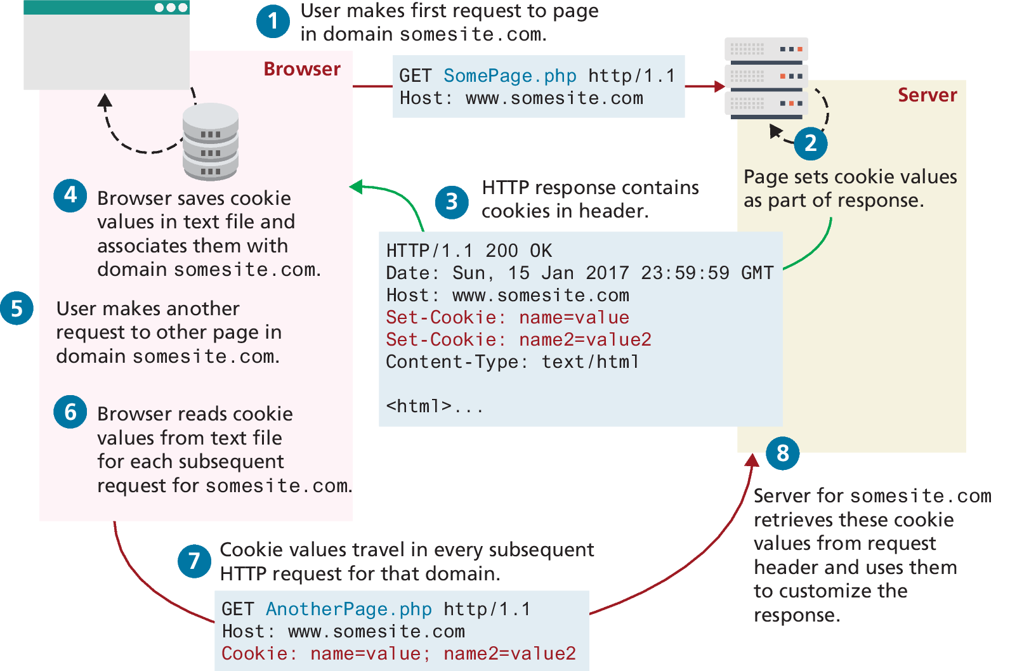
How Do Cookies Work?

Slide 15
Using Cookies in PHP
Cookies in PHP are created using the setcookie() function and are retrieved using the $_COOKIES superglobal associative array,
It is important to note that cookies must be written before any other page output.
$expiryTime = time()+60*60*24;
// create a persistent cookie
$name = "username";
$value = "Ricardo";
setcookie($name, $value, $expiryTime);
LISTING 15.2 Writing a cookie
if ( !isset($_COOKIE['username']) ) { echo "this cookie doesn't exist"; }
else {
echo "The username retrieved from the cookie is:“. $_COOKIE['username’];
}
// loop through all cookies in request
foreach ($_COOKIE as $name => $value) {
echo "Cookie: $name = $value";
}
LISTING 15.3 Reading a cookie

Slide 16
Using Cookies in Node and Express
Cookie support in Node and Express (cookie-parser) needs to be installed using npm.
save JSON data as a cookie value
read and write signed cookies
const express = require('express');
const app = express();
const cookieParser = require('cookie-parser');
app.use( cookieParser() );
app.get('/', (req, resp) => { // retrieve a single named cookie
console.log( req.cookies.username );
const entries = Object.entries(req.cookies);
for (const [name, value] of entries) {// loop through all cookies
console.log(`${name} = ${value}`)
}
// now write new cookie as part of response
const opts = {
maxAge: 24 * 60 * 60 * 1000, // 1 day
httpOnly: true
}
resp.cookie( 'theme', 'dark', opts );
resp.send('content sent to browser');
});
LISTING 15.4 Using cookies in Node and Express

Slide 17
Persistent Cookie Best Practices
Due to the limitations of cookies your site’s correct operation should not be dependent upon them.
Almost all login systems are dependent upon IDs sent in session cookies
Cookies containing sensitive information should have a short lifetime
A login cookie might contain the username but not the password. Instead, the login cookie would contain a random token used by the site’s back-end database. Every time the user logs in, a new token would be generated and stored in the database and cookie.

Slide 18
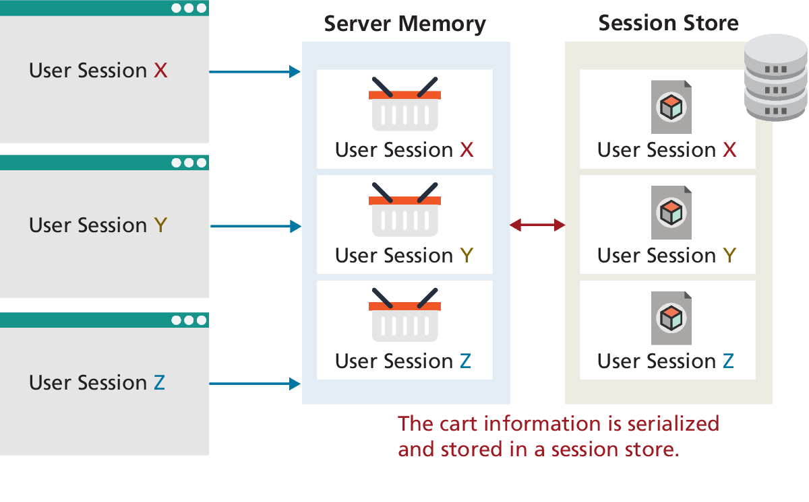
Session State
Session state is a server-based state mechanism that lets web applications store and retrieve objects of any type for each unique user session.
Session state is dependent upon some type of session store, that is, some type of storage area for session information.

Slide 19
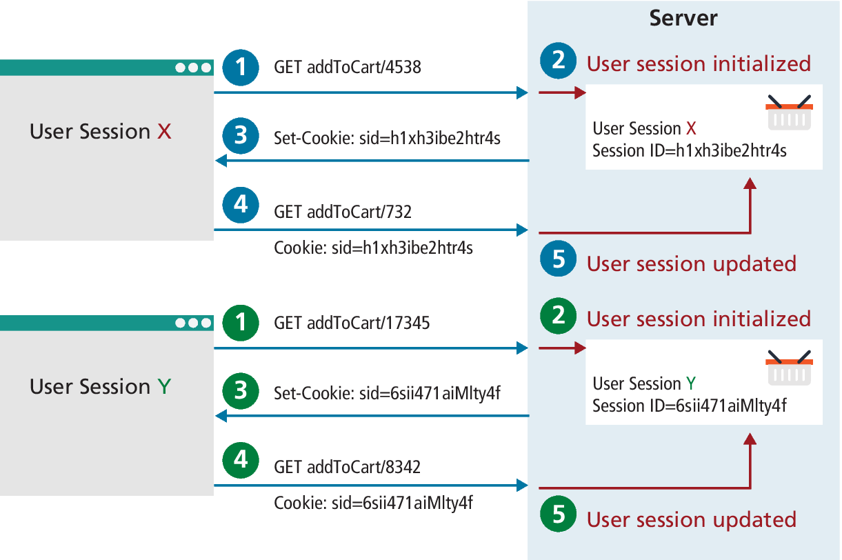
How Does Session State Work?
Since HTTP is stateless, some type of user/session identification system is needed.
Sessions in PHP and Express are identified with a unique session ID.
This session ID transmitted back and forth between the user and the server via a session cookie

Slide 20
Session Storage and Configuration
In the example shown in Figure 15.8, each user’s session information is kept in serialized files
The decision to save sessions to files rather than in memory addresses the issue of memory usage that can occur on shared hosts as well as persistence between restarts.
One downside to storing the sessions in files is a degradation in performance compared to memory storage.

Slide 21
Session State in PHP
Session in PHP can be accessed via the $_SESSION variable, but unlike the other superglobals, you have to take additional steps first.
You must call the session_start() function at the beginning of the script
If the session object does not yet exist one might generate an error, redirect to another page, or create the required object
<?php
include_once("ShoppingCart.class.php");
session_start();
// check for existence of session object before accessing
if ( !isset($_SESSION["Cart"]) ) {
$_SESSION["Cart"] = new ShoppingCart();
}
$cart = $_SESSION["Cart"];
?>
LISTING 15.8 Checking session existence

Slide 22
Session State in Node
There are two commonly used session packages for Express: express-session and cookie-session.
The express-session package supports different session stores, whether they be memory, files, external caches, or databases.
Listing 15.9 demonstrates how the express-session package could implement a simple favorites list.
const session = require('express-session');
// configure session middleware
app.use(session({
secret: process.env.SESSION_SECRET,
saveUninitialized: true,
resave: true,
cookie: { secure: true, htttpOnly: true }
}));
app.get('/addToFavorites/:prodid', function(req, resp) {
if (req.session.cart) {
const favorites = req.session.favorites;
favorites.push( req.params.prodid );
} else {
req.session.favorites = [ req.params.prodid ];
}
// send message or do something else
...
}
LISTING 15.9 Using express-session

Slide 23
Express-store mechanisms
The default express-session store mechanism is server memory, which isn't suitable for production environments. There are dozens of compatible session store packages that allow you to use a wide range of databases and cloud services for your session store. For instance, to configure MongoDB along with Mongoose, you can simply modify your session configuration as follows:
const mongoose = require('mongoose');
mongoose.connect(connectionOptions);
const MongoStore = require('connect-mongo')(session);
app.use(session({
...
store: new MongoStore({ mongooseConnection: mongoose.connection })
}));

Slide 24
Caching
As you learned back in Chapter 2, your browser uses caching to speed up the user experience. In Chapter 10, you learned about the Web Storage API, which provides a JavaScript-accessible cache managed by the browser.
Caching is just as important on the server-side.
Every time a PHP page is requested, it must be fetched, parsed, and executed by the PHP engine. Dynamic generation of that page may become unsustainable under high traffic load.
One way to address this problem is to cache the generated markup in server memory so that subsequent requests can be served from memory rather than from the execution of the page.

Slide 25
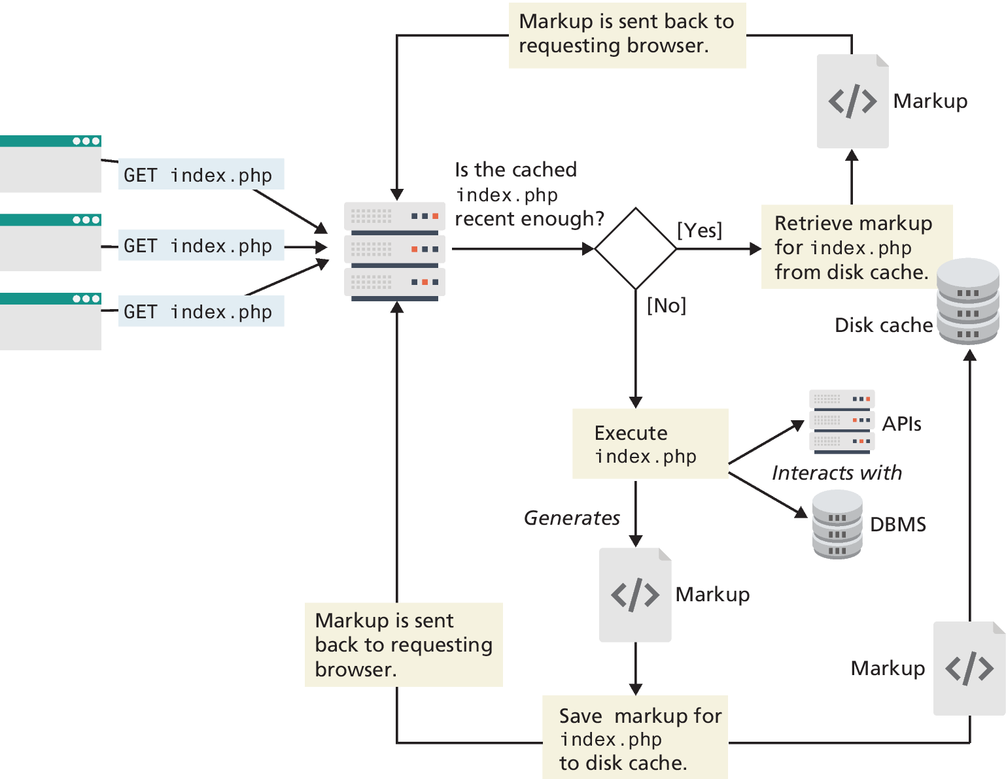
Page Output Caching
Page output caching saves the rendered output of a page (or part of a page) and reuses the output instead of reprocessing the page when a user requests the page again.

Slide 26
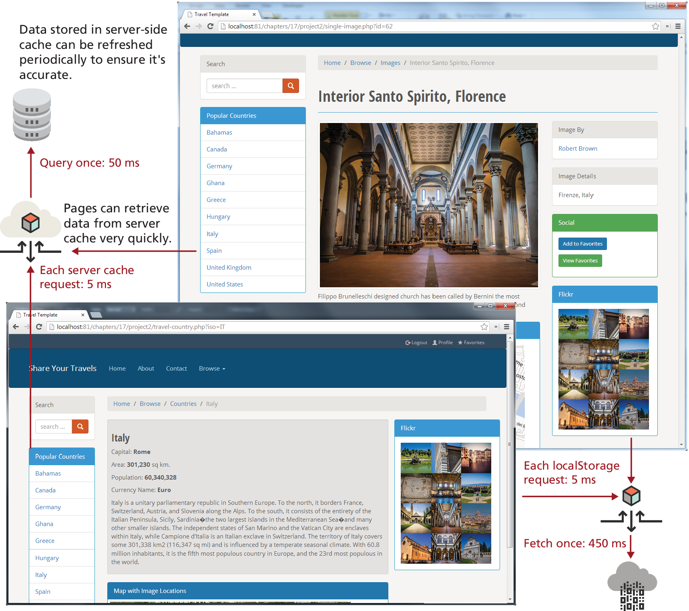
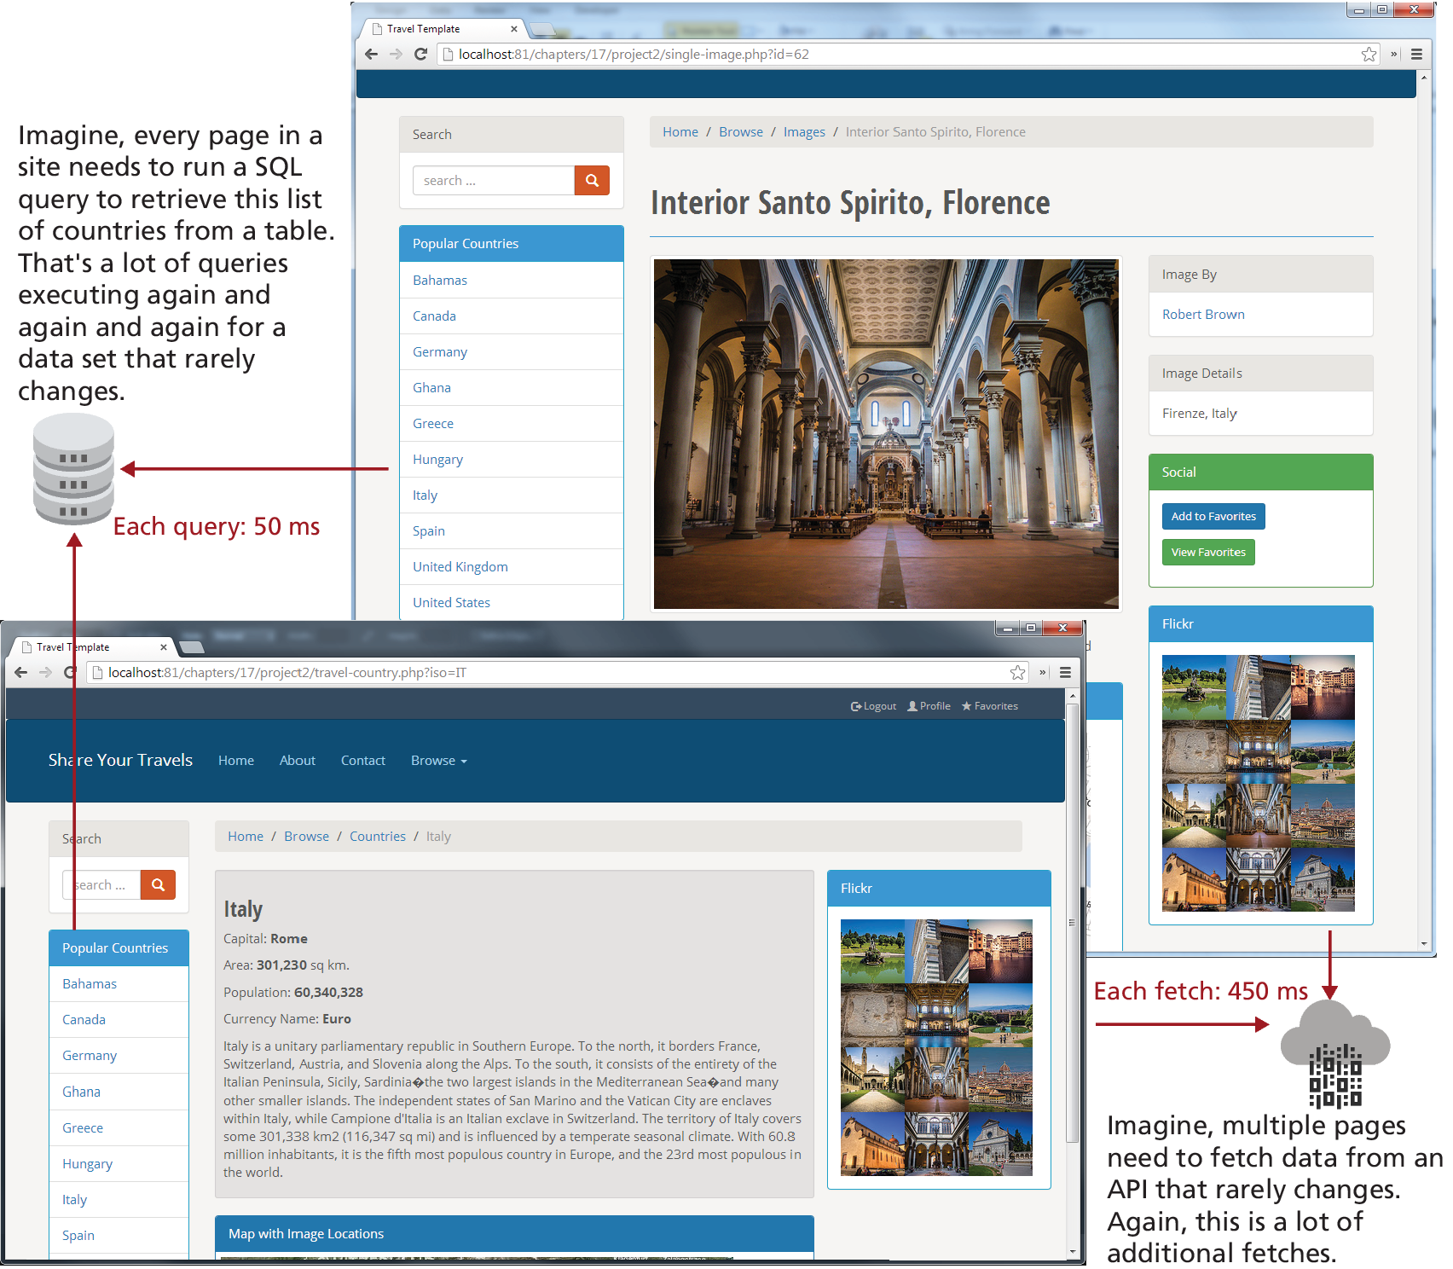
Use case for caching

Slide 27
Application Data Caching
One of the biggest drawbacks with page output caching is that performance gains will only be had if the entire cached page is the same for numerous requests.
Application data caching allows the developer to programmatically cache data commonly used collections of data. Then other pages that also need that same data can use the cache version rather than reretrieve it from its original location

Slide 28
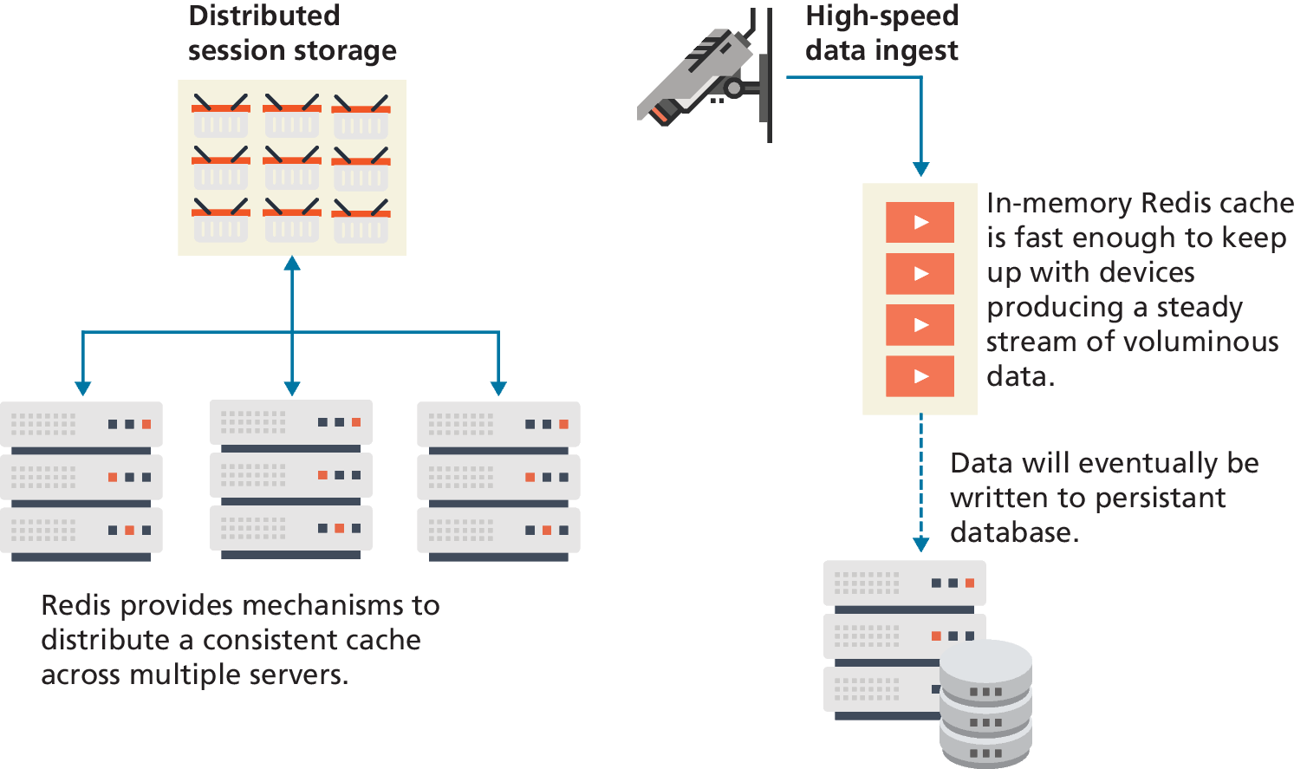
Redis as Caching Service
Redis is a popular in-memory key/value noSQL database that is frequently used for distributed caching.
Redis is an in-memory database. This means its speed of search and retrieval is very fast.

Slide 29
Key Terms
application data caching
cache
cookies
data eviction algorithms
deserialization
HttpOnly
page output caching
persistent cookies
serialization
session cookie
session state
session store
URL rewriting
write-back cache
write-though cache

Slide 30

Copyright
This work is protected by United States copyright laws and is provided solely for the use of instructors in teaching their courses and assessing student learning. Dissemination or sale of any part of this work (including on the World Wide Web) will destroy the integrity of the work and is not permitted. The work and materials from it should never be made available to students except by instructors using the accompanying text in their classes. All recipients of this work are expected to abide by these restrictions and to honor the intended pedagogical purposes and the needs of other instructors who rely on these materials.

